Slide 1

BCSC-0009 Software Engineering
UNIT-I
DEPT. CEA GLA UNIVERSITY MATHURA

Slide 2
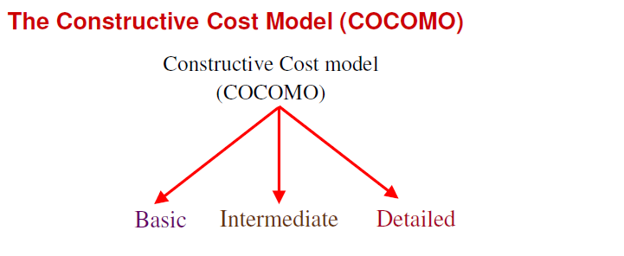
Software Project Planning

Slide 3
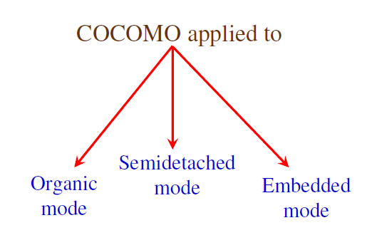
Software Project Planning

Slide 4
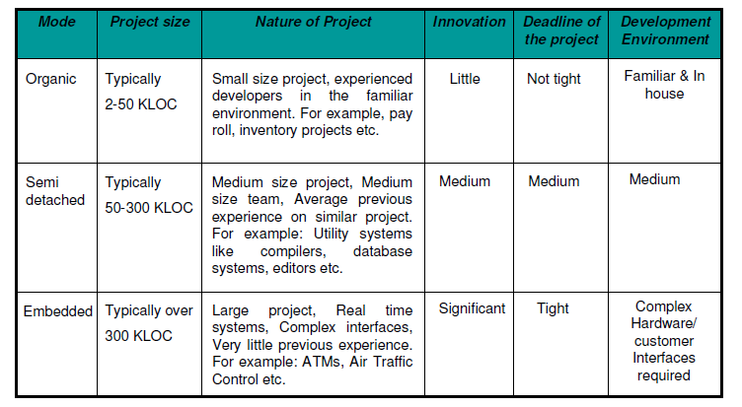
Software Project Planning

Slide 5
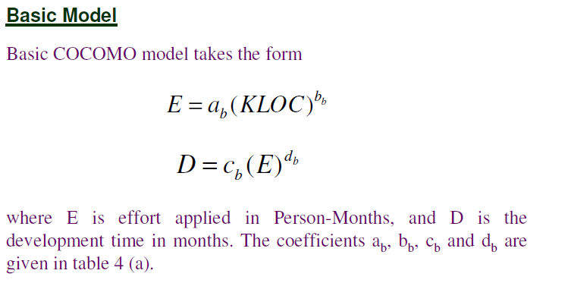
Software Project Planning

Slide 6
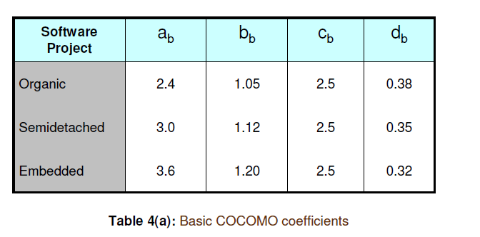
Software Project Planning

Slide 7
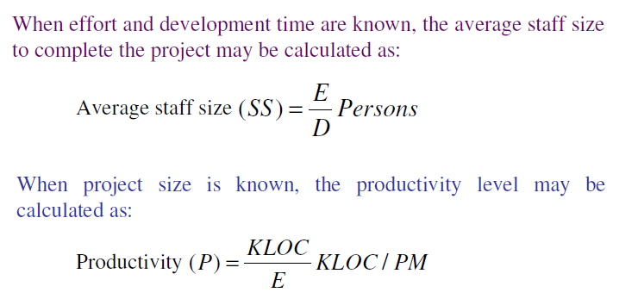
Software Project Planning

Slide 8
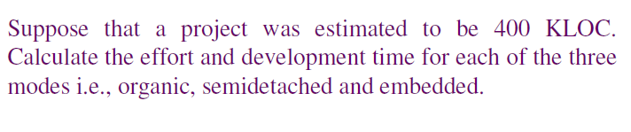
Software Project Planning

Slide 9
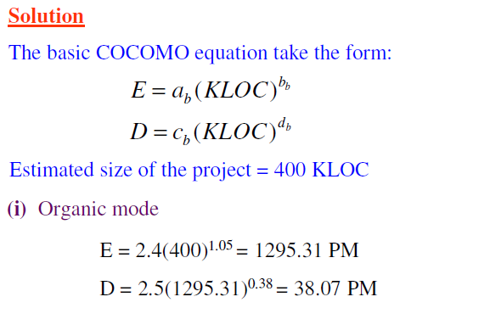
Software Project Planning

Slide 10
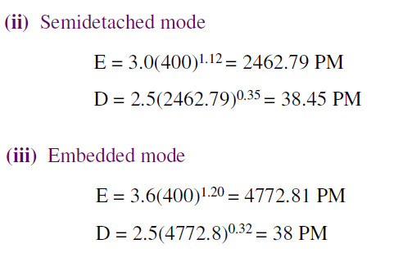
Software Project Planning

Slide 11
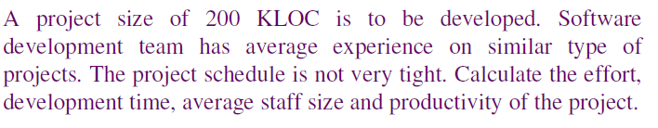
Software Project Planning

Slide 12
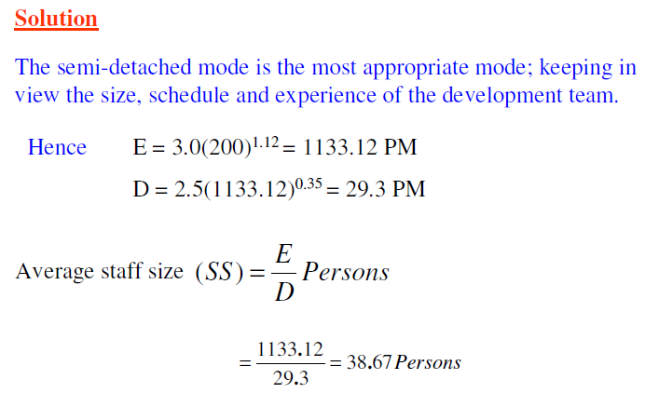
Software Project Planning

Slide 13
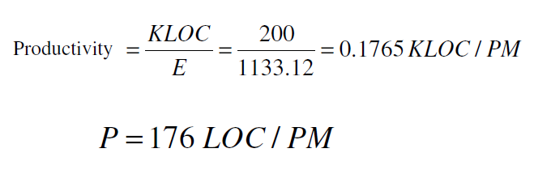
Software Project Planning

Slide 14
Software Project Planning
Cost Estimation Models:

Slide 15
Software Project Planning
2. Static, multivariable models:
Estimated desired values such as cost, time, effort. They all depend on the multiple variable (i.e. methods used, user participation, customer oriented changes, memory constraints) .
C= a . (L) ^{b}
C-> Cost, L-> Lines of code a & b are constants.
This model was developed by Walston and Felix at IBM provides a relationship between delivered lines of source code and effort:
single- variable Model:-
E= 1.4 (L) ^{0.93 Effort in Person Month}
D=4.6 (L) ^{0.26 Duration in Months}
multi- variable Model
E=5.2 (L) ^{0.91 Effort in Person Month}
D=4.1 (L) ^{0.36 Duration in Months}
^{L-> Thousand Lines of codes}

Slide 16
Software Project Planning
Question:

Slide 17
Software Project Planning
Question:

Slide 18
Software Project Planning
Question:

Slide 19
Software Project Planning
Question:
On the basis of Lines of code, SEL can produce four times as much software as IBM for same manpower and time scale.

Slide 20
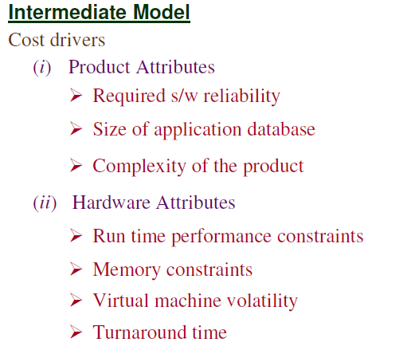
Software Project Planning

Slide 21
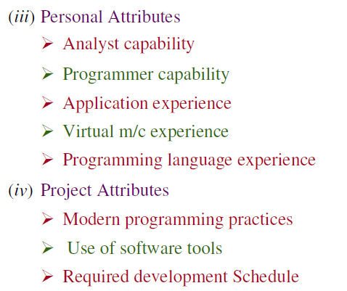
Software Project Planning

Slide 22
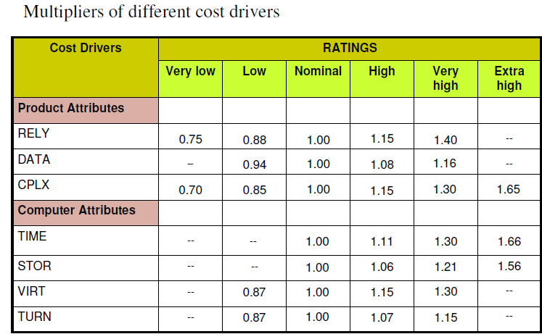
Software Project Planning

Slide 23
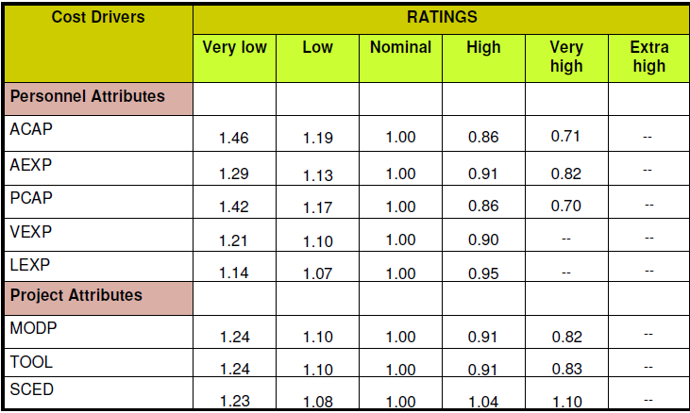
Software Project Planning

Slide 24
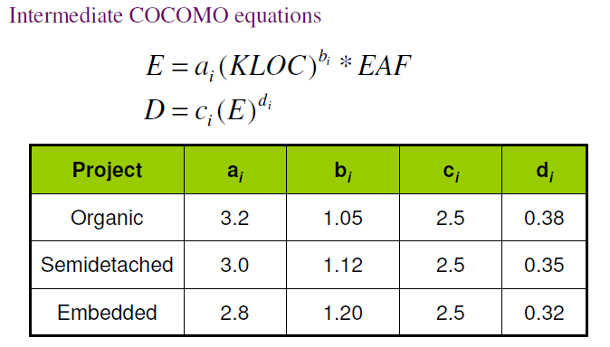
Software Project Planning

Slide 25
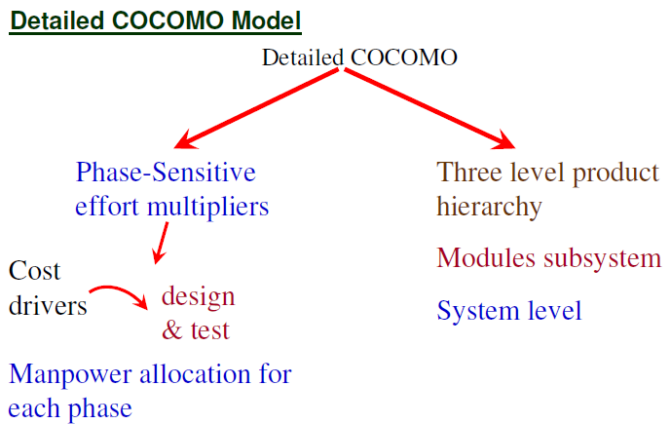
Software Project Planning

Slide 26
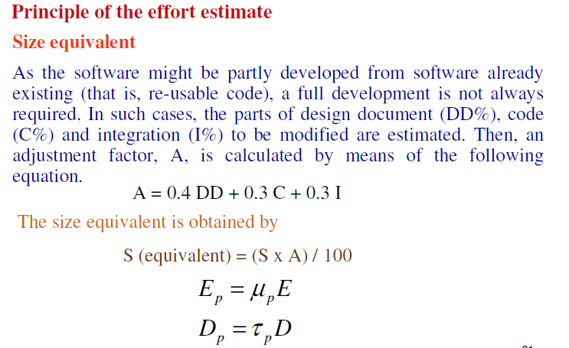
Software Project Planning

Slide 27
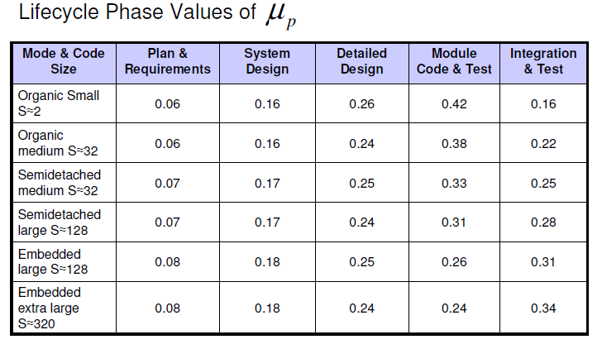
Software Project Planning

Slide 28
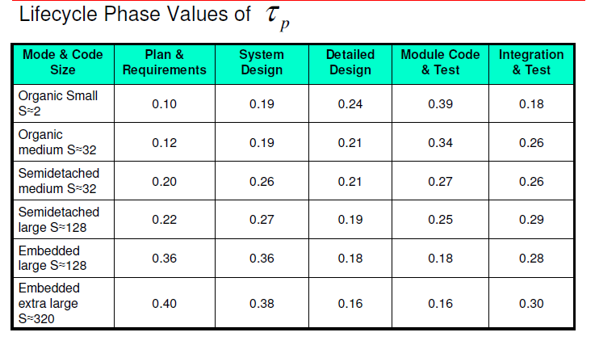
Software Project Planning

Slide 29
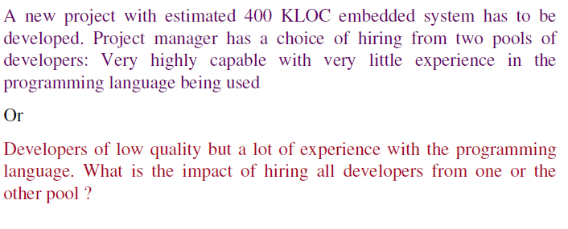
Software Project Planning

Slide 30
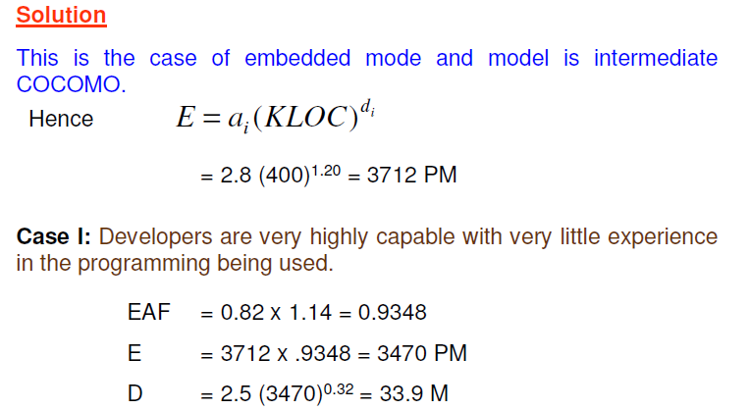
Software Project Planning

Slide 31
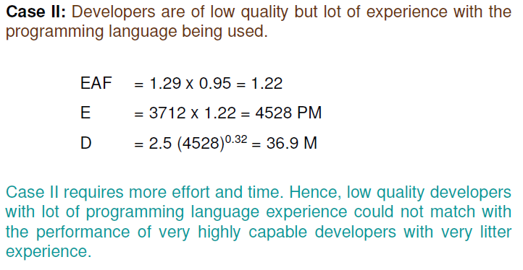
Software Project Planning

Slide 32
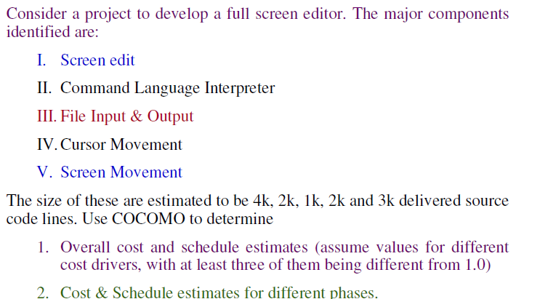
Software Project Planning

Slide 33
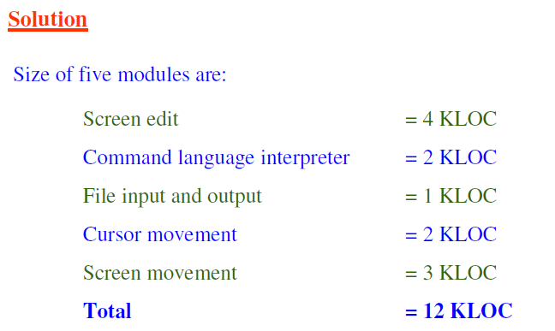
Software Project Planning

Slide 34
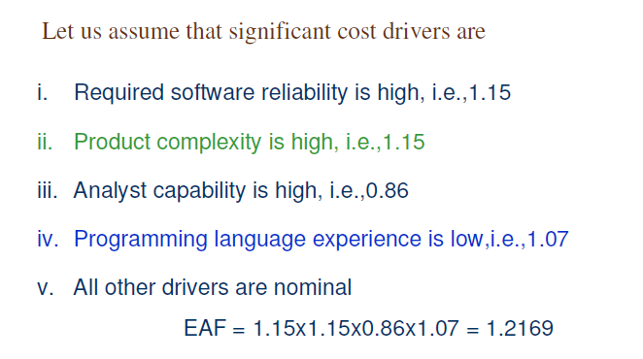
Software Project Planning

Slide 35
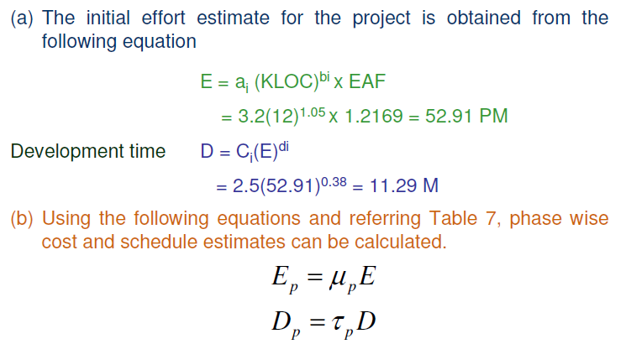
Software Project Planning

Slide 36
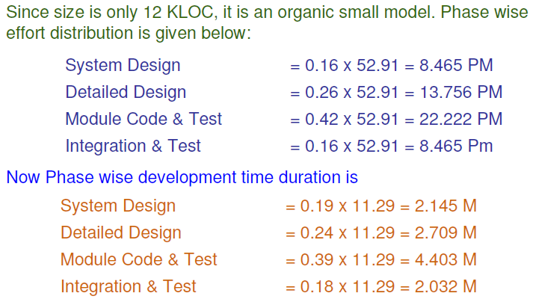
Software Project Planning

